Slide 1
Electrophysiology
Preparation for 3820 Demonstration

Slide 2
Types of brain recording
Electroencephalography EEG – scalp
EEG – subdural
Intracellular recording
Extracellular recording
Juxtacellular recording
Patch Clamp

Slide 3
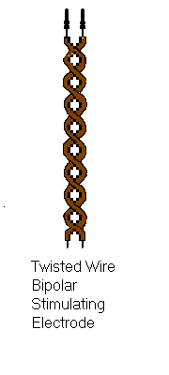
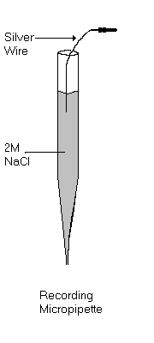
Recording Devices
Micropipette
Metal Microelectrode
Stereotrode/Tetrode
Carbon Fibre Electrode

Slide 4
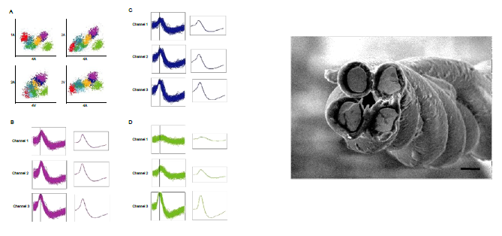
Tetrode cross section with spikes
http://www.itee.uq.edu.au/think/rodents

Slide 5
Spontaneous vs Evoked Activity
Spontaneous activity refers to the ongoing neural activity as the subject is behaving or sleeping.
Evoked activity is electrical activity in response to a stimulus… either external (such as a smell, sound, touch, light), or internal (electrical, chemical or light stimulation)

Slide 6
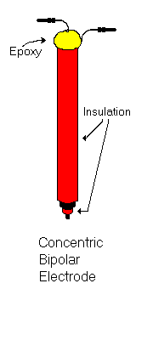
Our Demonstration
Extracellular recording of Granule Cells in the Dentate Gyrus of the Hippocampus using a micropipette
Stimulation of the Perforant Path – one of the main inputs to the Hippocampus using concentric bipolar electrode.
We will be looking at a field potential evoked by electrical brain stimulation

Slide 7
Stimulating & Recording Electrodes
Recording Pipette
Concentric Bipolar Stimulating Electrode

Slide 8
Action Potential vs Field Potential

Slide 9
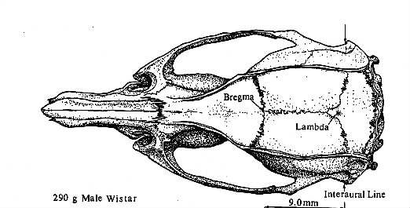
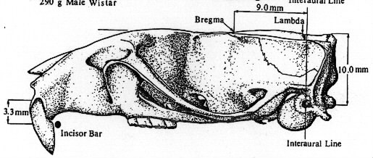
Top and side views of a rat skull.
Bregma and Lambda are intersections of bone plates on the dorsal skull surface.
The diagram indicates the approximate position of the interaural Line, but this reference point is not located anatomically. It is found on the stereotaxic instrument. (We will take a look at this later.)

Slide 10
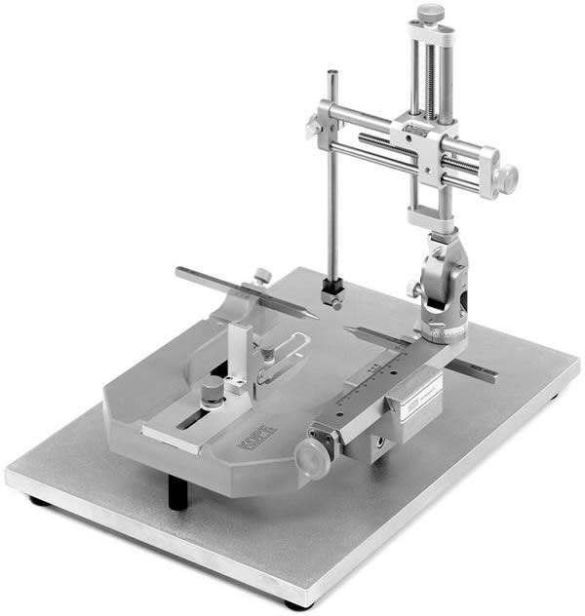
The Stereotaxic Instrument
The IAL (IAP, Stereotaxic zero)
Is the point where the ear bars meet. If you are using this as a reference point, you could place the tip of the electrode between the ear bars using the 3 drive screws. Record the AP, ML, & DV readings at this point. Structures are then located
With respect to these
Readings.

Slide 11
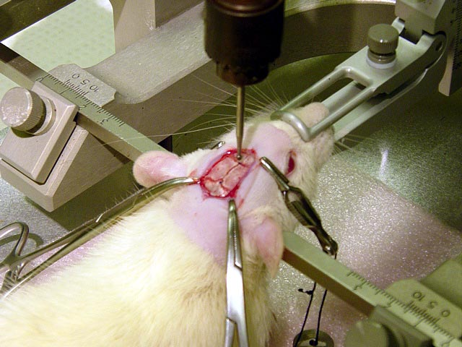

Slide 12
Electrodes in Position

Slide 13
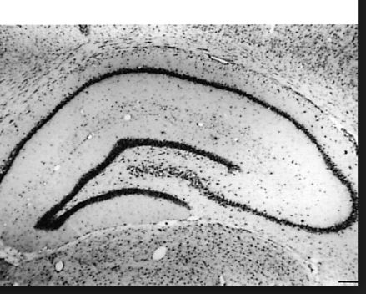
Depth profile of Perforant Path evoked potential in the hippocampus

Slide 14
Field Potential
Granule Cell response to PP stimulation

Slide 15
LTP Demonstration

Slide 17
What you see vs what you save
When we perform this experiment we’ll see the waveforms or field potentials on the oscilloscope.
What we save to the computer for analysis is a digital representation of the waveform.
We want that digital representation to be as accurate as possible.
Do that to a large extent through the settings on the A/D Converter.

Slide 18
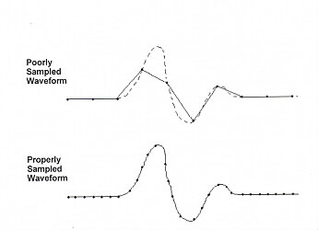
Sampling frequency : collect samples at a frequency sufficient
to give an accurate representation of the waveform

Slide 19
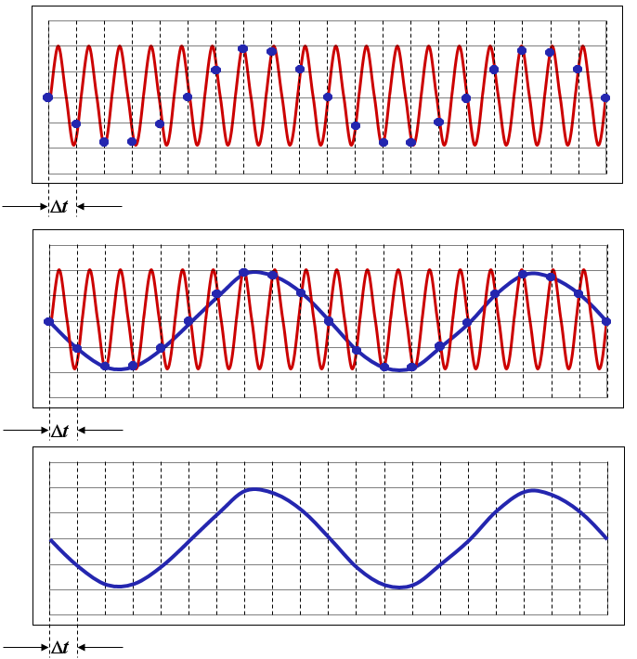
Aliasing
Notes:
This is similar to the effect of wheels spinning at impossibly slow speeds or backwards in old western movies due to frame rate of camera

Slide 20
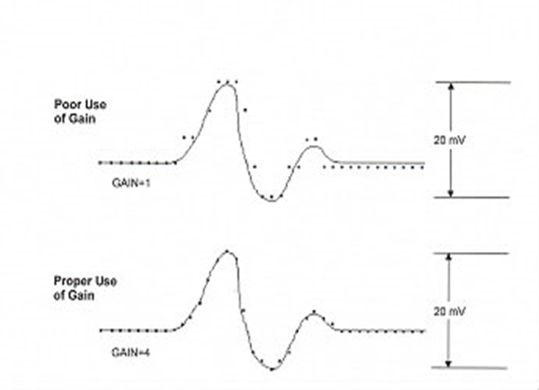
Amplify signal to use A/D range available.
Resolution: 12 bit A/D divides voltage into 4096 intervals
+/- 10 V = 4.88mV resolution +/- 5V =2.44 mV resolution
+/- 2.5V = 1.22 mV resolution +/- 1.25V = 0.61 mV resolution

Slide 21
Improper use of Gain

Slide 22
Proper use of gain

